Slide 1


AI-POWERED FOOTBALL ANALYTICS SYSTEM
Rascanu Dragos
International Student

Slide 2
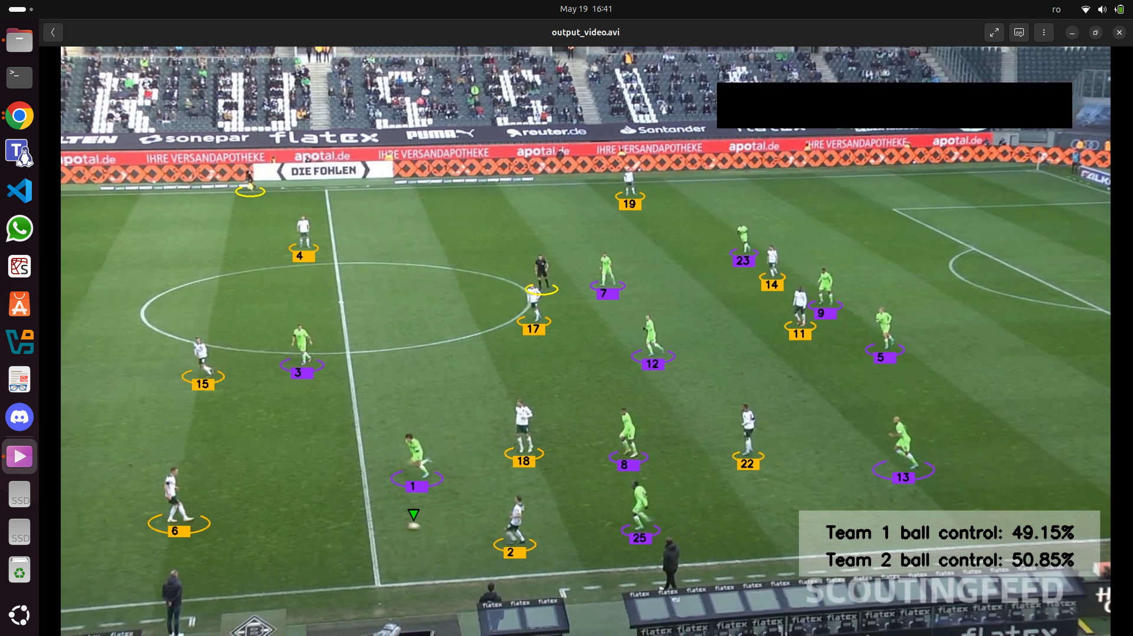


INTRODUCTION
OVERVIEW
This project focuses on automated football match analysis using computer vision.
The system processes full-length match video to extract structured insights such as player tracking, ball possession, tactical zones, and team performance indicators.
Our pipeline includes several key components: detection of players, ball, and referees using a YOLOv8x model, object tracking with ByteTrack and team assignment using spatial and color-based logic. Another YOLOv8x model for pitch detection, homography mapping to project movements onto a 2D pitch; and tactical board generation, including Voronoi diagrams.
The system accepts any broadcast football video as input and automatically annotates it with visual overlays, generates Voronoi diagrams, and builds the 2D tactical board, enabling rich, match-wide analysis without manual intervention. (careful to delete stubs when inputting a new video)

Slide 3
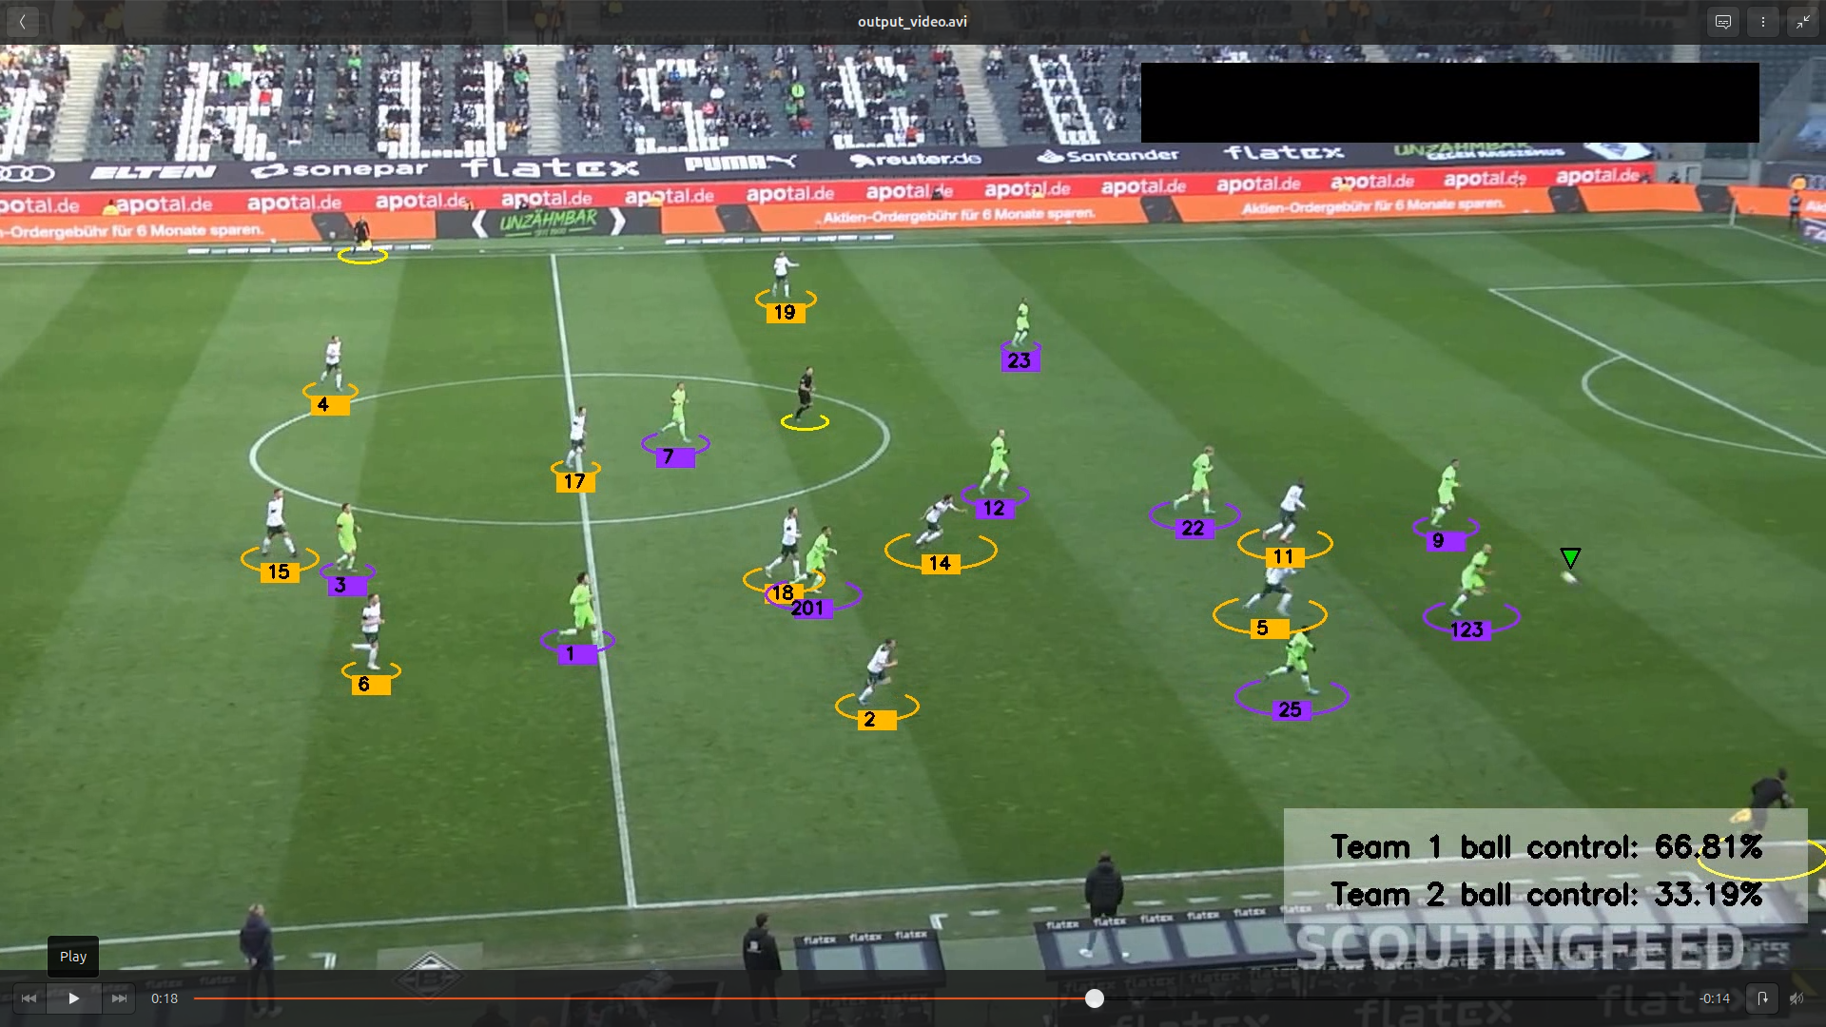

Liceria & Co.
INTRODUCTION
OBJECTIVE
The objective of this project is to analyze football footage to extract tactical information, such as player movement, ball possession, and spatial control.
By leveraging computer vision techniques and homography, we aim to project detections from the video onto a 2D pitch layout, allowing clear visualization of strategy and control.
The system identifies players, assigns teams, and tracks their positions and movement over time, supporting post-match analysis and coaching applications.

Slide 4
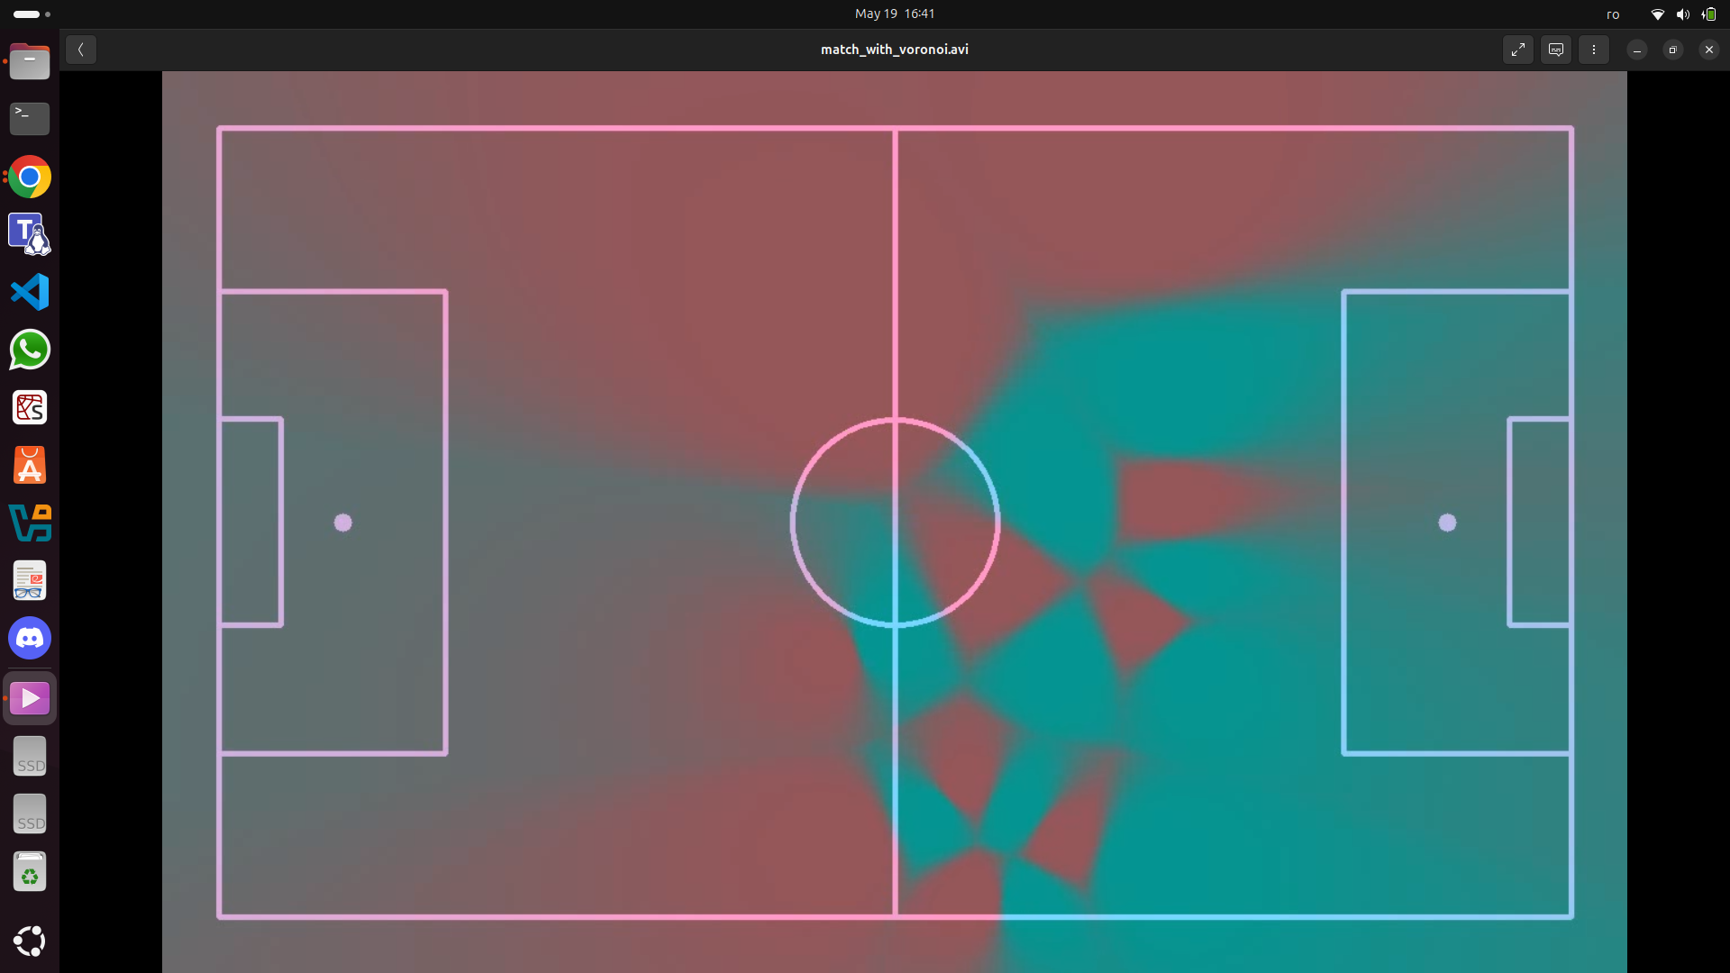
DATASET
The second dataset also featured images, but focused on football pitches captured from various angles, with key vertices marked at relevant points across the field. A total of 32 distinct points were defined, though no single image included all of them simultaneously.
Both datasets provided a variety of challenges, such as changing camera angles, partial occlusion, and varying lighting, which were important in testing the robustness of the system. Both of them were found on roboflow.
Liceria & Co.
The primary dataset consisted of images from football matches, where each player, referee, and the ball were annotated and categorized into specific classes. A YOLOv8x model was trained on this dataset, enabling it to detect individuals in each frame and return their bounding boxes.
INFORMATION ABOUT DATASET

Slide 5

TRAINING AND TUNING
Player Detection Model
Two separate models were trained for this project. The first, a YOLOv8x model for player, ball, and referee detection, was trained locally using the Ultralytics CLI with a batch size of 6, 50 epochs, and an image resolution of 960×960. The training used the command-line interface and Roboflow-exported data.yaml for streamlined integration. Model was trained on kaggle, jupyter notebook is called: train-pl-det.ipynb
Pitch Model
The second model, used for detecting pitch keypoints, was trained on Kaggle to leverage GPU acceleration. Both models were tuned using appropriate confidence thresholds and data augmentations to handle lighting variation, occlusions, and perspective distortions. These steps were crucial for enabling stable tracking and accurate homography projection in downstream tasks.
Liceria & Co.

Slide 6
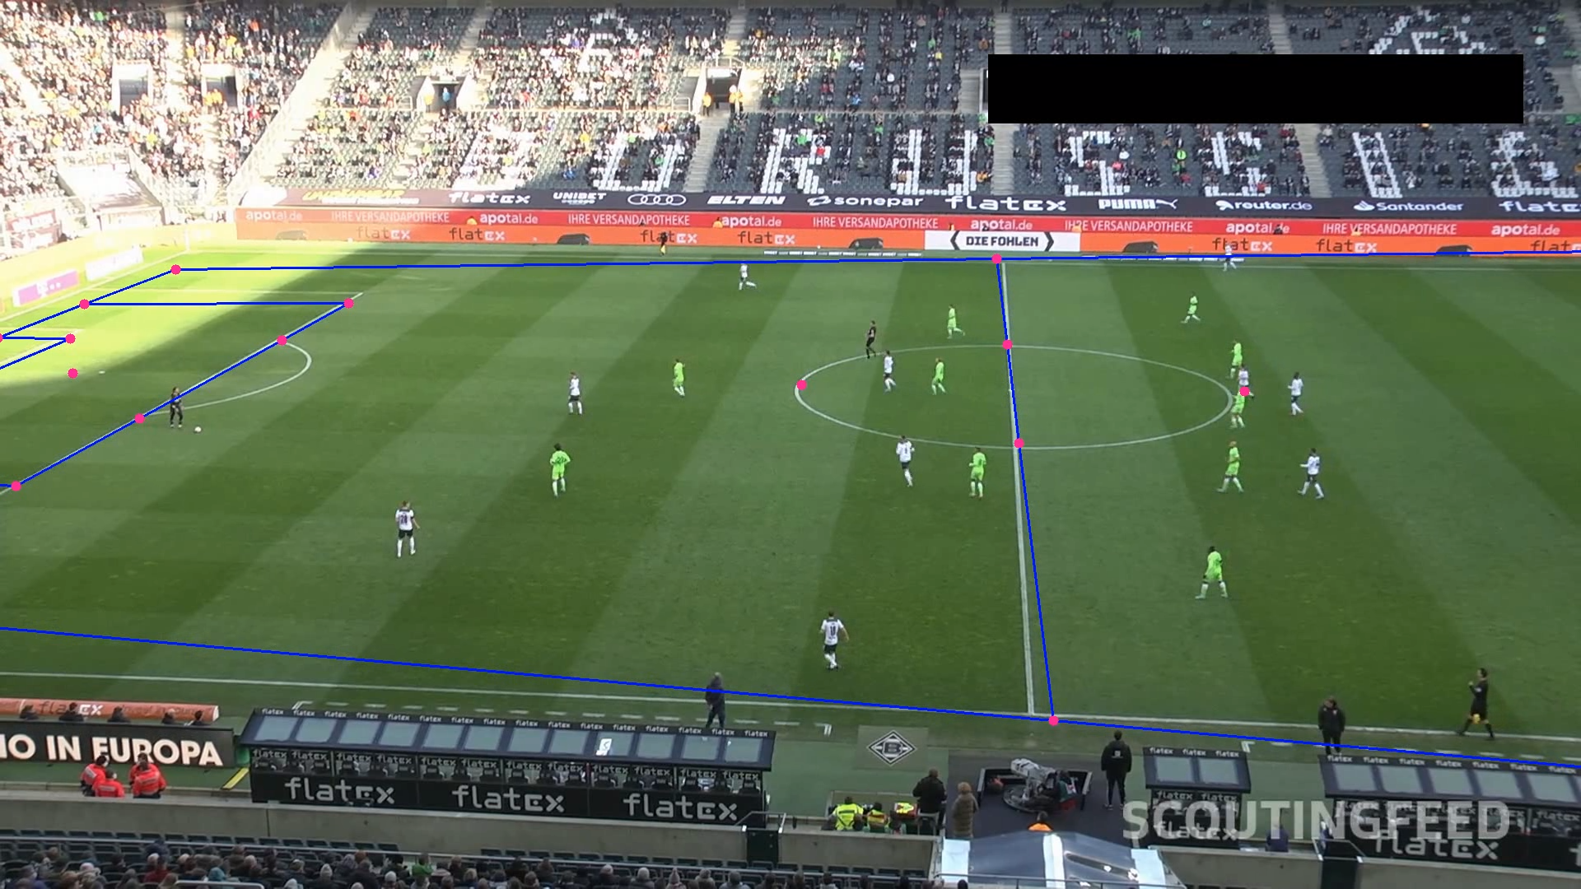
To enable accurate spatial analysis, we computed a homography transformation by identifying and matching key pitch landmarks—such as penalty boxes, center circle, and touchlines—between the image space (camera view) and a standardized 2D pitch model. This transformation was encapsulated in a dedicated ViewTransformer class, which handled the conversion of player positions and bounding boxes from pixel coordinates into pitch coordinates.
As a result, all detected entities could be projected onto a static top-down pitch representation, effectively decoupling the analysis from camera motion, angle, and zoom. This projection allowed for consistent, metric-space reasoning across frames, enabling downstream tasks such as player tracking, heatmap generation, team formation analysis, and spatial statistics.
HOMOGRAPHY AND FIELD PROJECTION
Liceria & Co.

Slide 7

TEAM POSSESSION
ASSIGNING TEAMS
This module uses a trained image-based classifier to predict each player's team based on their jersey crop, sampled periodically from the video. Crops are extracted from detection bounding boxes, and the model is fit on a balanced subset of frames to ensure reliable team color recognition.
SMOOTHING AND CENTROIDS
Team assignment benefits from temporal smoothing: a short history (deque of 3 frames) is maintained per player, and a majority vote is used to stabilize predictions over time - reducing flickering due to occlusion or misclassification.
Additionally, the module handles goalkeeper classification using spatial logic. Player positions are grouped per team and used to compute centroids.
Liceria & Co.

Slide 8
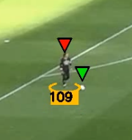
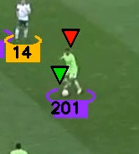
BALL INTERPOLATION AND PLAYER ASSIGNMENT
To maintain consistent ball tracking across frames linear interpolation is used. The interpolate_ball_positions method reconstructs the ball’s trajectory by identifying its center in detected frames and linearly interpolating positions in frames with missing data. Fixed-size bounding boxes are then generated around the interpolated centers to preserve compatibility with downstream modules.
Once the ball’s position is stabilized, it’s dynamically assigned to a player using the assign_ball_to_player method. This function calculates the distance between the ball’s center and each player’s foot position (extracted from the bounding box). The closest player is considered in control, provided the distance is below a predefined threshold (max_player_ball_distance).

Slide 9
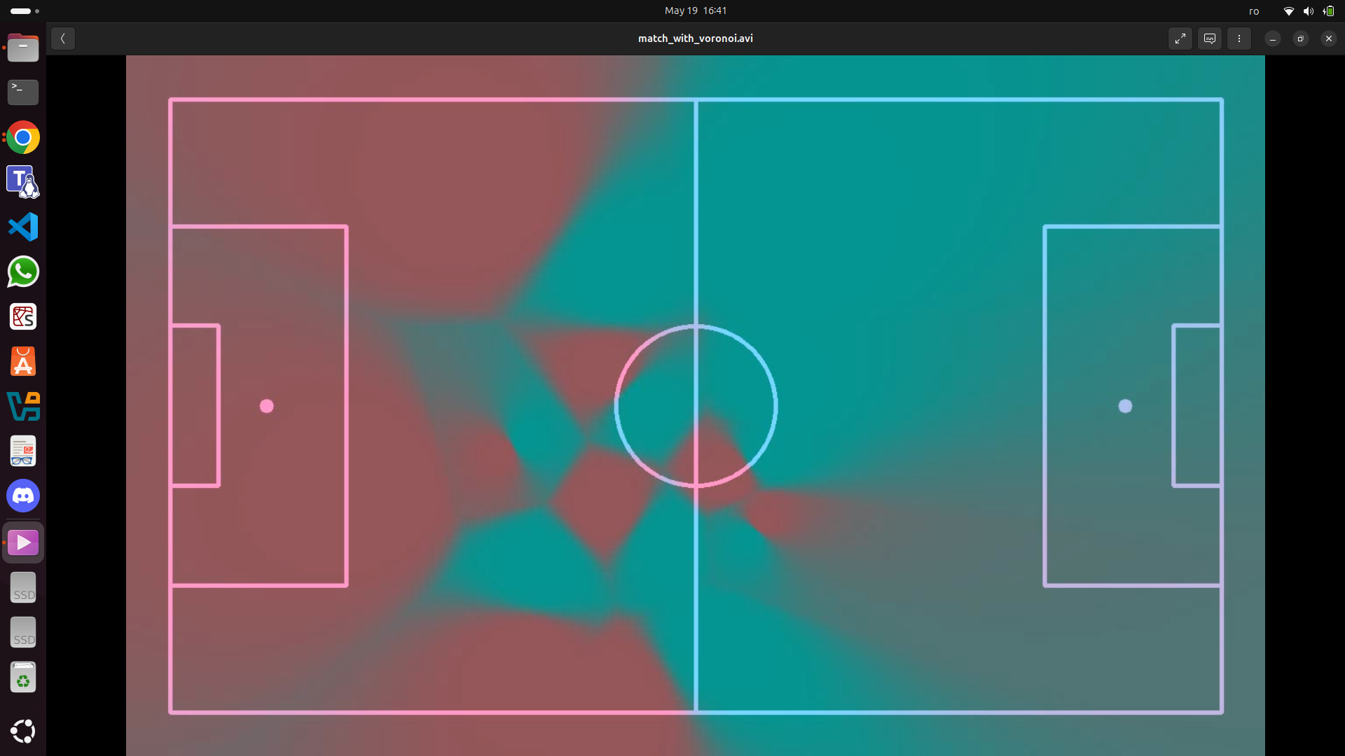
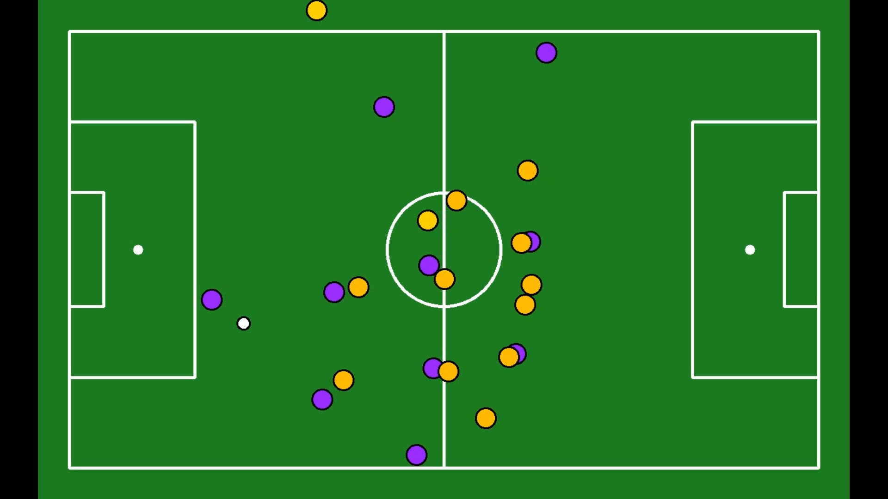
TACTICAL BOARD
The 2D tactical board provides a clean and informative visualization of player and ball positions over time, projected onto a standardized static pitch. Each player is represented by a colored circle, with color indicating their assigned team, while referees are shown in gold and the ball is displayed in white. This abstraction removes the visual noise and camera motion present in broadcast footage, enabling clearer analysis of player spacing, team formations, and positional discipline.
VORONOI CONTROL ZONES
VISUALIZATION
To further enrich spatial understanding, Voronoi diagrams are generated using the pitch-projected positions of all players. These diagrams partition the pitch into zones of influence, where each region corresponds to the area closest to a particular player. This visualization layer is particularly useful for identifying which team controls various parts of the field at any given moment, revealing tactical aspects such as numerical overloads, pressing traps, compactness in defense, and vulnerabilities in formation.

Slide 10
Ellipses Overlays
Contextual Visualization
Team Possession Display
Ball Possessor Pointer
Distinct shapes for players, goalkeepers, referees, and the ball enhance visual clarity in the broadcast video
Model predictions are directly mapped onto the real-world scene for intuitive interpretation.
Real-time indicator shows which team is currently in control of the ball.
A dynamic pointer highlights the player currently in possession, updating live with game flow.
In addition to the abstract tactical board, the original broadcast video feed is augmented with overlays to maintain visual context. Ellipses are drawn around players, goalkeepers, referees, and the ball, each with distinct styling to differentiate roles.
These overlays complement the raw footage by providing immediate visual cues about entity classification and positioning, allowing observers to connect model predictions back to the real-world scene. Furthermore, the system displays current team possession as an on-screen label, helping track the flow of the game.
A dynamic pointer highlights the player currently in possession of the ball, updating in real time as passes or turnovers occur. This enriched video layer, paired with the tactical board, delivers a comprehensive and intuitive interface for match analysis, blending clarity with contextual depth.
MAIN VIDEO VISUALIZATION
FOOTBALL ANALYSIS SYSTEM

Slide 11
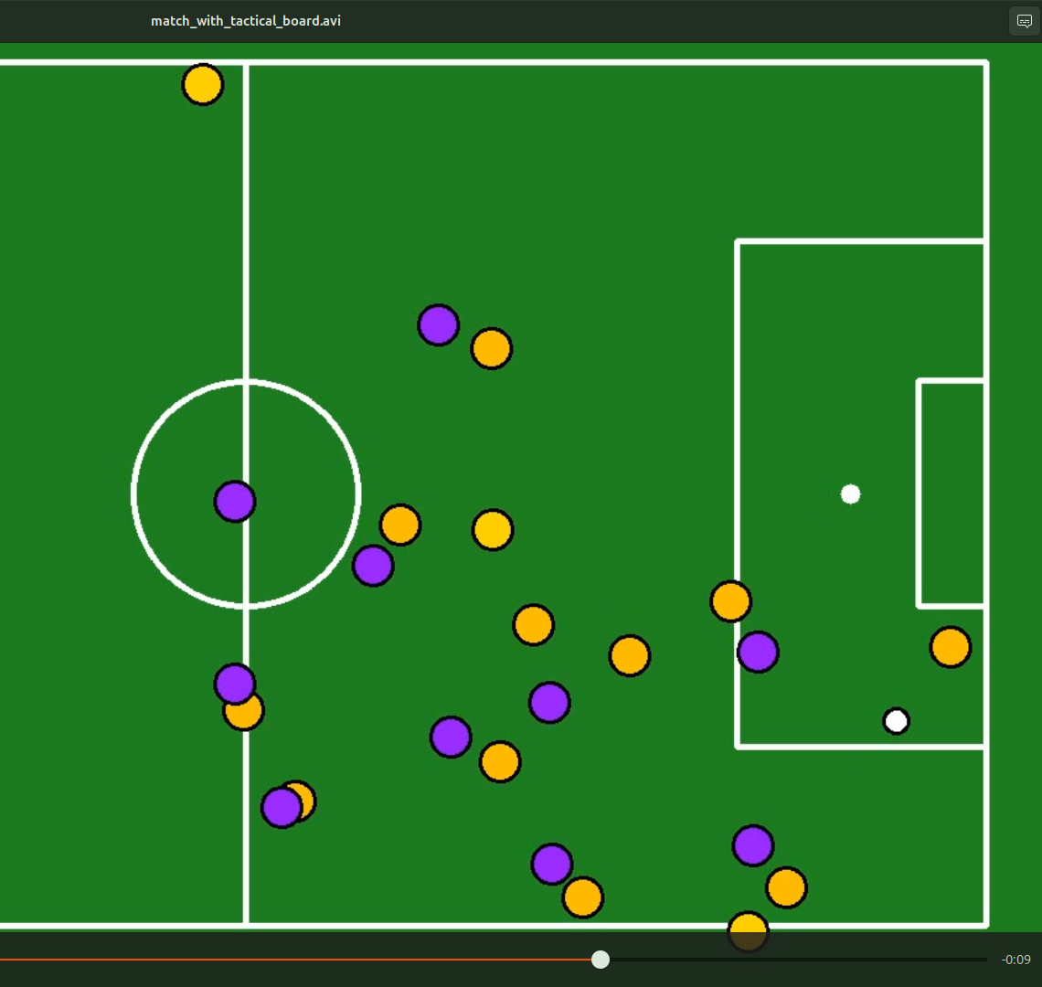
HYPERPARAMETER TUNING
DYNAMIC METRICS
LOCAL TRAINED PITCH MODEL
While the system performs reliably, several enhancements could further improve accuracy and insight. Larger and more diverse datasets could be explored to improve generalization, and training the models for longer periods may yield better detection stability across challenging conditions.
Functionally, we plan to add dynamic metrics such as each player’s total distance traveled and real-time speed, providing deeper performance analysis. Additionally, visualizing the full path of the ball on the 2D pitch would enhance tactical understanding.
Although the system is already time-efficient, the pitch keypoint model currently runs via Roboflow’s API. Hosting it locally could significantly reduce inference latency and improve end-to-end processing speed.
LIMITATIONS AND FUTURE IMPROVEMENTS
The World’s Favorite Sport
Liceria & Co.

Slide 12

RESULTS
Liceria & Co.
The system successfully processed the full video, generating synchronized visualizations of team ball control, player movement, and tactical structure. The visual outputs were stable across frames, and the Voronoi zones reflected team shapes and positional dominance well. The ball tracking system, supported by interpolation, performed consistently even when detections were temporarily lost.
THANK YOU
This project demonstrates a robust pipeline for football video analysis using detection, tracking, projection, and visualization. It achieves accurate player tracking, team assignment, ball control inference, and tactical mapping.
Project link
Player Detection Model download link

